Slide 1
Game AI (Game Engines 2)
Dr Bryan Duggan
Dublin Institute of Technology

Slide 2
What we will learn today
Unity basics
The framework code for the examples on this course
Implementing steering behaviours in Unity

Slide 3




Unity is an platform for making games
Features
Game engine
Scene editor
3D or 2D Games
GameObjects, GameComponents
PhysX and Box2D physics
Class library
Bindings for C#, Boo and JavaScript
Uses MONO (Open Source .Net)
Runtimes for PC, Mac, Linux, IOS, Android etc etc.

Slide 4
In industry
Huge presence at GDC
Very popular amongst indies
Free & Pro versions
Free for games up to 100K
Pro version has a few extra features
Including Rift support
Pro version is expensive
75 Euro PM

Slide 5
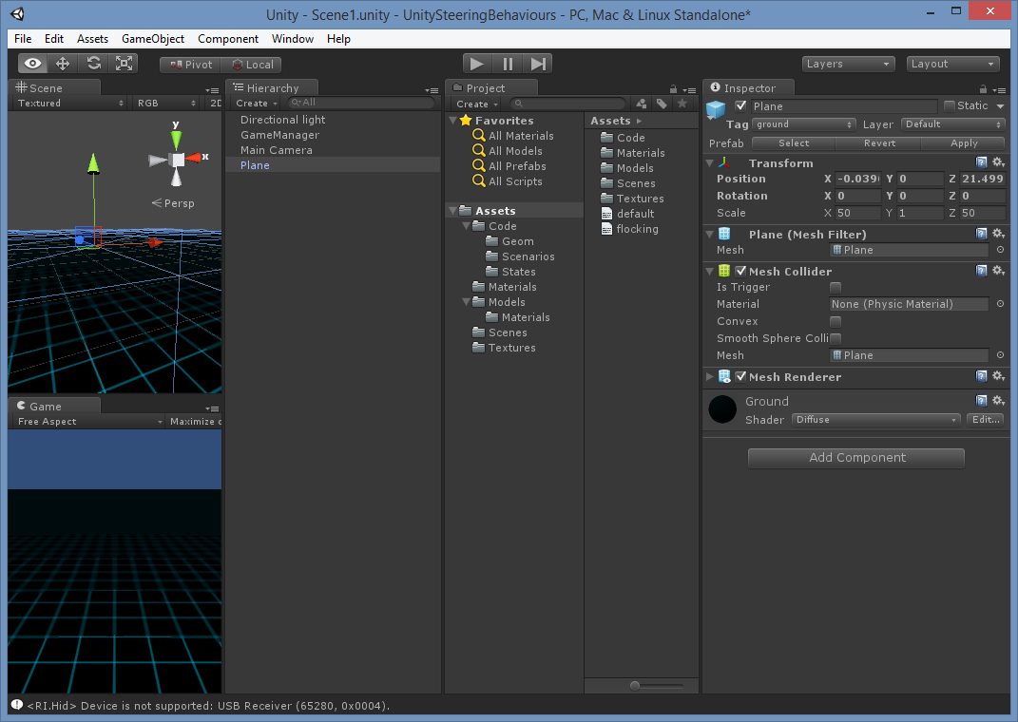

Slide 6
Concepts
GameObject
Represents anything in the scene
Has a Transform object
Does not draw itself! (Thats what a GameComponent is for)
Can contain other GameComponents
Can be attached to other GameObject’s
Parent’s transform is multiplied into the child’s
You rarely extend GameObject
GameComponent
Contained by a GameObject (GameObject’s can have multiple GameComponents attached)
Start – Called at the start of the lifetime
Update – Called once per frame
Use Time.deltaTime to get the time delta

Slide 7
Concepts
Transform
Contains forward, up and right vectors
A quaternion called rotation
A position vector
Probably has a world transform, but its not visible?
This is the object that controls the GameObject’s world transform
Renderer
A subclass of GameComponent
There are lots of subclasses for different types of drawable object

Slide 8
Useful Classes
Vector3
x, y, z fields (lowercase)
+, -, * / overloaded
magnitude (lowercase)
Dot, Cross, Normalize (static methods)
Use the static fields forward, right and up to get the basis vectors
Quaternion
w, x, y, z fields (lowercase)
* is overloaded for quaternions and vectors
* a vector rotates the vector by the quaternion
Use:
Quaternion q = Quaternion.AngleAxis(90, Vector3.up);
To make one!
Angle is in degrees

Slide 9
Matrix operations
Are not supported!
Instead use a quaternion for rotations and
Transform object for everything else (including rotations)
E.g:
Vector3 target = Vector3.zero;
target = leader.transform.TransformPoint(offset);
To transform a point by the transform
Also:
TransformDirection
InverseTransformDirection
InverseTransformPoint

Slide 10
Creating GameObjects in code..
Create a “prefab” (a game object with some components attached)
This is done automatically when you import a model
Create a public field in the game component
This exposes the field to the Unity editor
Drag the prefab over to the field in the editor
Write code:
boid = (GameObject) GameObject.Instantiate(prefab);
boid.tag = "boid";
boid.AddComponent<SteeringBehaviours>();
boid.transform.position = position;

Slide 11
Referencing other GameObjects/GameComponents
Use the tag to assign a string tag to the object
Use:
GameObject[] obstacles = GameObject.FindGameObjectsWithTag("obstacle");
GameObject obstacles = GameObject.FindGameObjectWithTag("obstacle");
Use:
leader.GetComponent<SteeringBehaviours>()
To get a component of a GameObject

Slide 12
Debugging C# Code
Can’t use VisualStudio without an expensive plugin
Instead use MonoDevelop
The .sln .csproj files get regenerated each time you build your project
Add these to your .gitignore file
Set breakpoints etc in MonoDevelop
Choose Run | Attach to Process in MonoDevelop
Unity must be already running but not running your project
Run the project in Unity

Slide 13
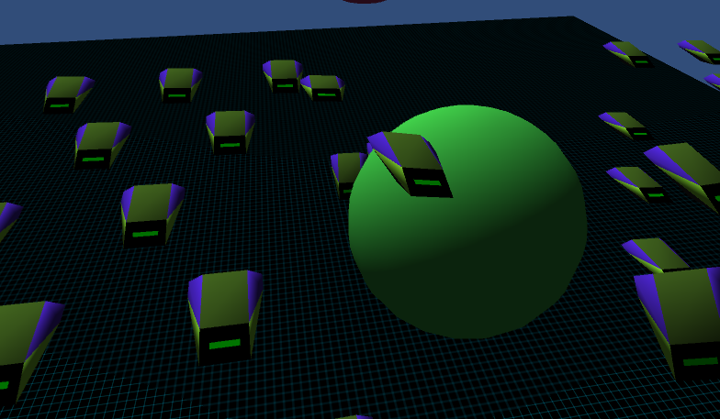
My Game AI Framework!

Slide 14
Main Classes
SteeringBehaviours
A GameComponent
Implements all the behaviours!
You must call Params.Load before using
Uses bit masking to control which behaviours are turned on
Has properties that are exposed in Unity
SteeringManager
A singleton
Attached to a GameObject with no renderer
Used to control which scenario is run
Displays the HUD
Handles turning on and off various display settings
Exposes the prefabs required by the scenarios
Should not be necessary if you are using the Unity editor to create scenes

Slide 15
Main Classes
Scenario
Base class for each of the demos
Has Setup, Update and TearDown methods
Handles mouse clicks to move the targetPos of the behaviours
leader is a special game object
TearDown removes all the objects from the scene
Special tags!
Boid, obstacle, MainCamera

Slide 16
Subclasses
SeekScenario
ArriveScenario
PursueScenario
StateMachineScenario
PathFollowingScenario
PathFindingScenario
ObstacleAvoidanceScenario

Slide 17
Bitmasking
Allows you to store lots of booleans in a single int value
First create a mask with the bit you want
int mask = 1 << 5
Operations
Set a bit
OR with the mask
Clear a bit
AND with the inverse of the mask
Toggle a bit
XOR with the mask
Read a bit
AND with the mask and check for non zero

Slide 18
In code:
public bool isOn(behaviour_type behaviour)
{
return ((flags & (int)behaviour) == (int)behaviour);
}
public void turnOn(behaviour_type behaviour)
{
flags |= ((int)behaviour);
}
public void turnOff(behaviour_type behaviour)
{
flags &= ( ~ (int)behaviour);
}

Slide 19
Offset pursuit (3D)
Used to program fleets (amongst other things)
Similar to pursue but with 2 differences
The agent pursues an offset (in local space) of the target agent
Transform the offset by the target agents Transform object to get the target
Use dead reckoning same as pursue
We use arrive instead of seek to keek in formation

Slide 20
Code...
Vector3 OffsetPursuit(Vector3 offset)
{
Vector3 target = Vector3.zero;
target = leader.transform.TransformPoint(offset);
float dist = (target - transform.position).magnitude;
float lookAhead = (dist / Params.GetFloat("max_speed"));
target = target + (lookAhead * leader.GetComponent<SteeringBehaviours>().velocity);
checkNaN(target);
return Arrive(target);
}

Slide 21
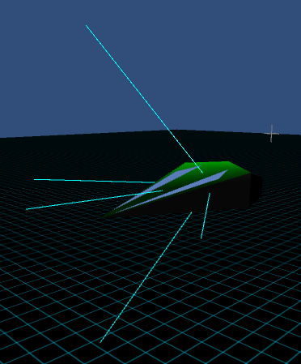
Wall Avoidance (3D)
Uses “feelers”
Points projected in front of the agent
3 for 2D 5 for 3D
Make them in local space
Use the forward basis vector and a quaternion to make them
Transform to world space
Can use Plane geometry to check the points

Slide 22
In code...
Vector3 newFeeler = Vector3.forward * feelerDistance;
newFeeler = transform.TransformPoint(newFeeler);
Feelers.Add(newFeeler);
newFeeler = Vector3.forward * feelerDistance;
newFeeler = Quaternion.AngleAxis(45, Vector3.up) * newFeeler;
newFeeler = transform.TransformPoint(newFeeler);
Feelers.Add(newFeeler);
newFeeler = Vector3.forward * feelerDistance;
newFeeler = Quaternion.AngleAxis(-45, Vector3.up) * newFeeler;
newFeeler = transform.TransformPoint(newFeeler);
Feelers.Add(newFeeler);
newFeeler = Vector3.forward * feelerDistance;
newFeeler = Quaternion.AngleAxis(45, Vector3.right) * newFeeler;
newFeeler = transform.TransformPoint(newFeeler);
Feelers.Add(newFeeler);
newFeeler = Vector3.forward * feelerDistance;
newFeeler = Quaternion.AngleAxis(-45, Vector3.right) * newFeeler;
newFeeler = transform.TransformPoint(newFeeler);
Feelers.Add(newFeeler);

Slide 23
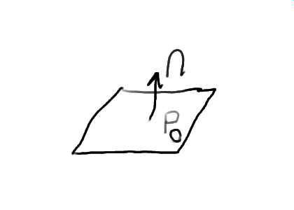
Planes
Can be described using a point on the plane and a normal vector, a vector perpendicular to the plane

Slide 24
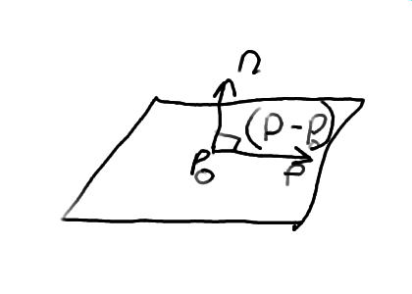
Equation of a plane
Remember
Cos(90) = 0, so
If A and B are perpendicular vectors: A.B = 0
The equation of a plane is given by
n.(p – p₀) = 0

Slide 25
Equation of a plane
n.(p-p0) Can be written as:
n.p –n.p0 (Distributive)
We can therefore write the equation as: n.p + d = 0 Where d = -n.p0
d is also shortest signed distance from the origin to the plane
A plane is 4 values A, B, C and D
A, B, C are the normal
D is the shortest signed distance to the plane

Slide 26
Planes in Unity

